Slide 1
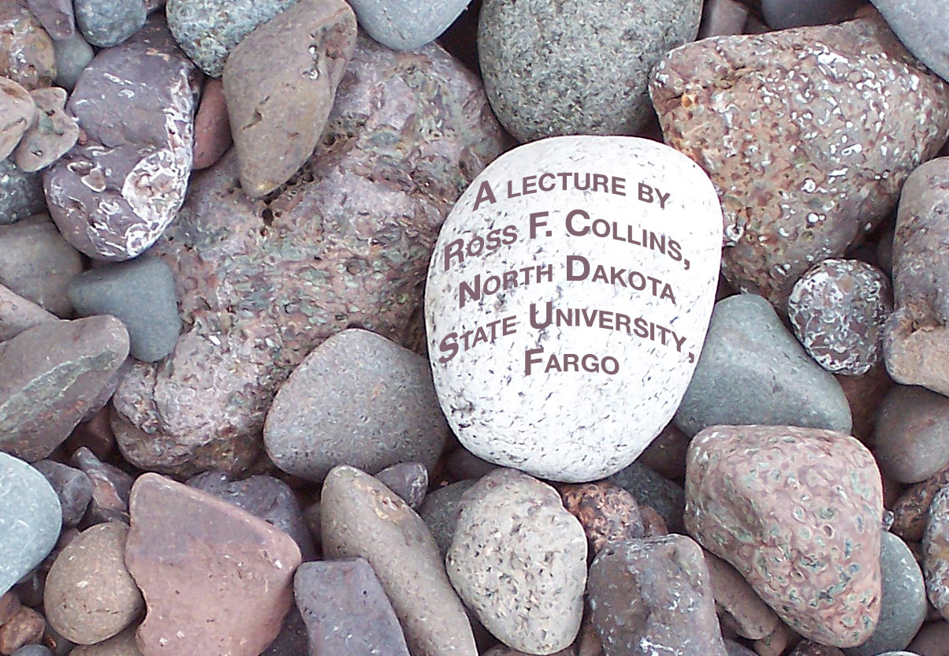
Cutlines
People doing things

Slide 2
Cutlines
Mass media is about people doing things.
We can tell the story in words, or visually.
Usually we do a little of both: we put text and illustrations together.

Slide 3
Telling a story
Photojournalism aims to tell stories visually.
But usually it also relies on a few words.
The words we use to help describe a photo is called a cutline.
Sometimes it’s called a caption. Strictly speaking, the two are different, but most people consider them pretty much the same.

Slide 4
Cutlines
The word cutline is based, like many journalism terms, on obsolete technology.
In the days of hot type (metal), photographs were engraved onto metal plates.
The metal plates were cut from large sheets. Photos were therefore called cuts.

Slide 5
Why cutlines?
Most mass media editors won’t accept photos for publication without cutlines.
Because photojournalism is fact-based photography, photographers try to capture a factual portrayal.
But still photography is limited by the medium: it captures a slice of time, a moment, without past, and without future.

Slide 6
Context
To help readers understand the circumstances around the photo, we add written information. We add context.
Some photos are ambiguous without cutlines. What is happening in the photo in the next slide?

Slide 7
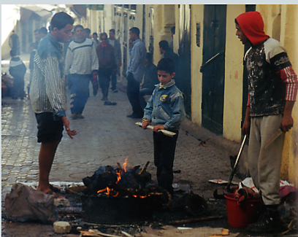
What is happening?
Describe what you think you see.

Slide 8
We need a cutline
Unless you are familiar with Muslim culture, you have no way to understand this photo without a cutline. Here is the cutline:
Muslims celebrate Eid Al Adha, the feast of sacrifice, on a street in Fez, Moracco. One of the two most important Muslim holidays, it is celebrated by each family. A live sheep is ritually slaughtered in the kitchen as a symbol of sacrifice. The sheep head often ends up charred on a street-side brazier while children play in the sun with glistening sheep intestines.

Slide 9
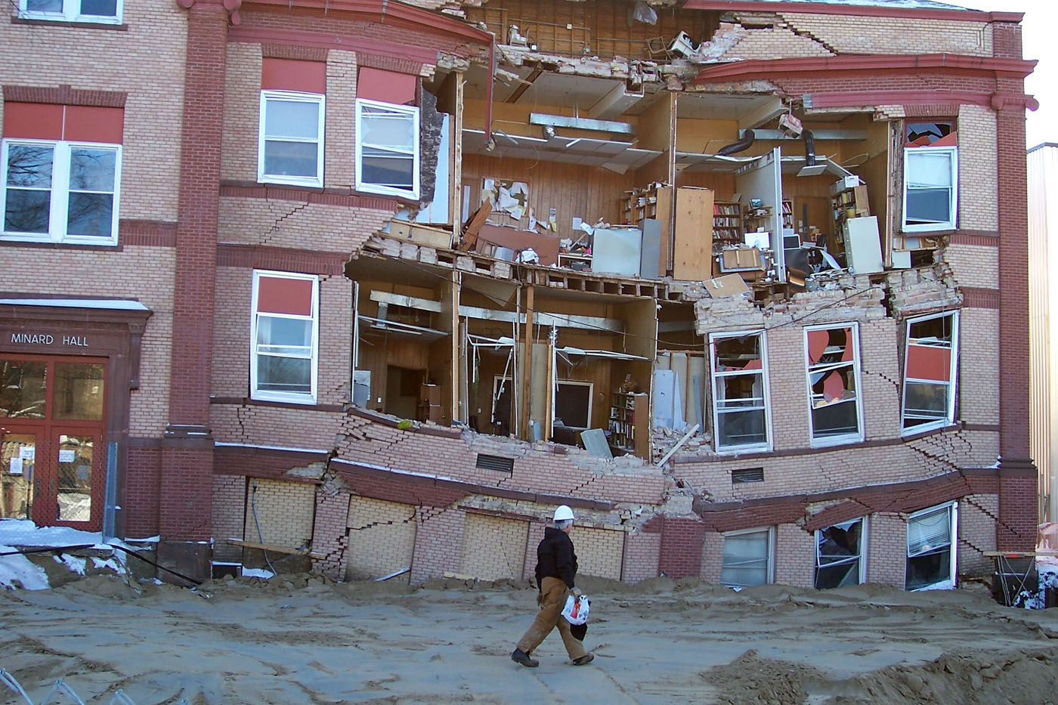
Misinterpretation
Sometimes a cutline helps guide our interpretation. We can sort of guess what happened here. But we need explanation and context.

Slide 10
IDs
Most editors won’t accept photos of identifiable people unless those people are identified. Cutlines provide the names, and often the significance of those in the photo.
An editor also likes to see people named in cutlines because it implies (though not legally) permission to publish their picture.
It also sells more newspapers—or, presumably, obtains more online hits.

Slide 11
Cutline limits
Sometimes no matter what the cutline says, the emotional power of the photo is so shocking we just can’t believe what we’re reading.
Visual images often have more power than words.

Slide 12
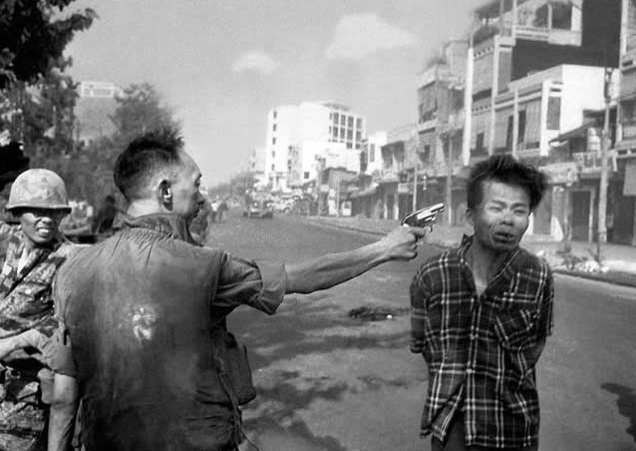
Power of the image
This execution photo became one of the most memorable of the Vietnam war era.
While we may read the executed prisoner was a terrorist who had just murdered several people, nevertheless, the photo is so shocking we can’t accept a written explanation, no matter how reasonable.

Slide 13
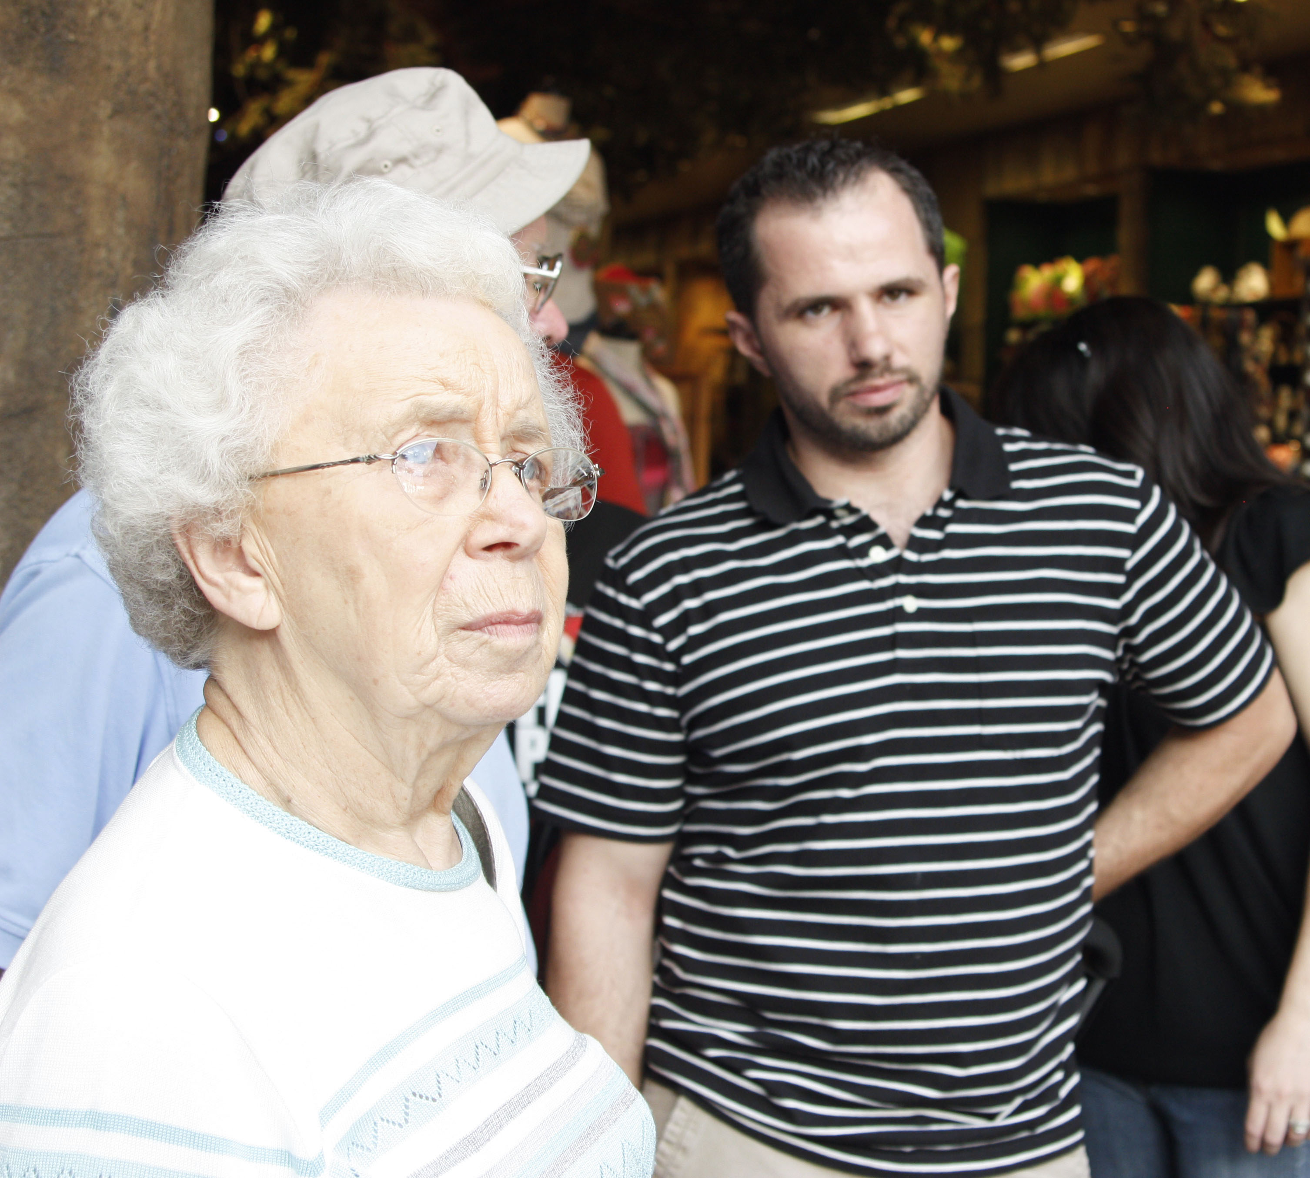
Ethics and cutlines
Photojournalists have the obligation to accurately reflect the photo in a cutline. Journalism should be factual. To suggest a false context is lying.

Slide 14
Accurate cutlines
In the photo above, we might read this cutline:
“Erma Nern and Irving Nern watch President Obama speaking at Disney World Tuesday.”
Is this accurate? The reader has no way of knowing. It is Disney World. And it is Erma and Irving. And Obama was there.

Slide 15
Accurate cutlines
But the photojournalist did not get a usable picture of the audience listening to the speech. So he took a photo of people watching an attraction nearby, and not directly at the president.

Slide 16
Writing cutlines
Rule One: cutlines must be in the present tense. In the example above, the people obviously were watching something (not the president, as we found out), in the past. But we say “watch,” not “watched,” using present tense.
Why do we do this? It’s a somewhat artificial construction journalists use to emphasize timeliness. They want to give readers the feeling it’s happening NOW. Even if it happened, oh, yesterday.

Slide 17
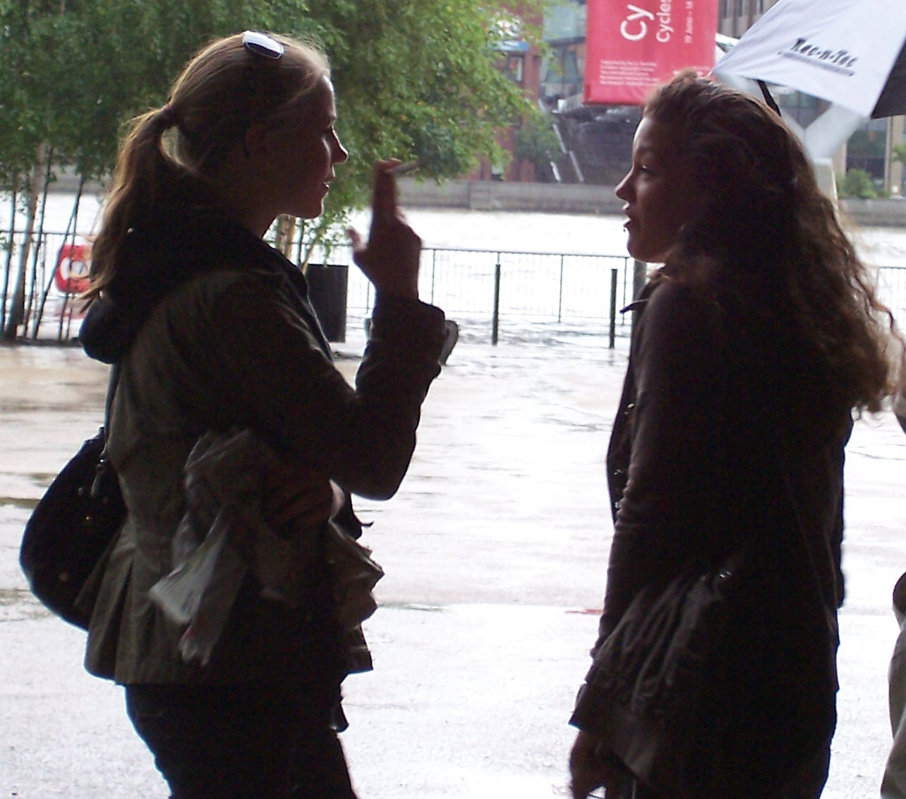
Writing cutlines
Rule Two: Don’t state the obvious. Try to add information not found in the story.
Photo cutline: “Two women smoke outside.” Well, duh.

Slide 18
Writing cutlines
Add information, such as “Erma and Norma Nern wait outside on a rainy day to see the new Cy Twombly exhibit at the Tate Modern in London.”

Slide 19
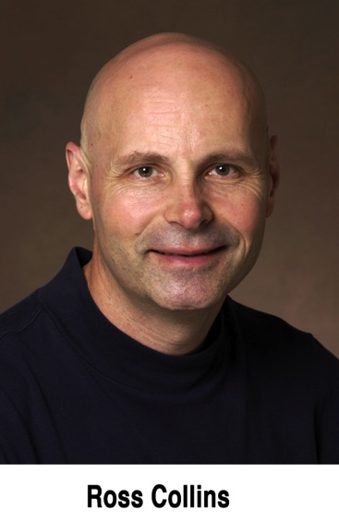
Writing cutlines
Avoid obvious words such as “The photo shows” or “Above we can see.” Not necessary.
Keep cutlines short. Don’t write a story in a cutline.
Cutlines should be complete sentences, except for mugshots. These small portraits can include just the name.

Slide 20
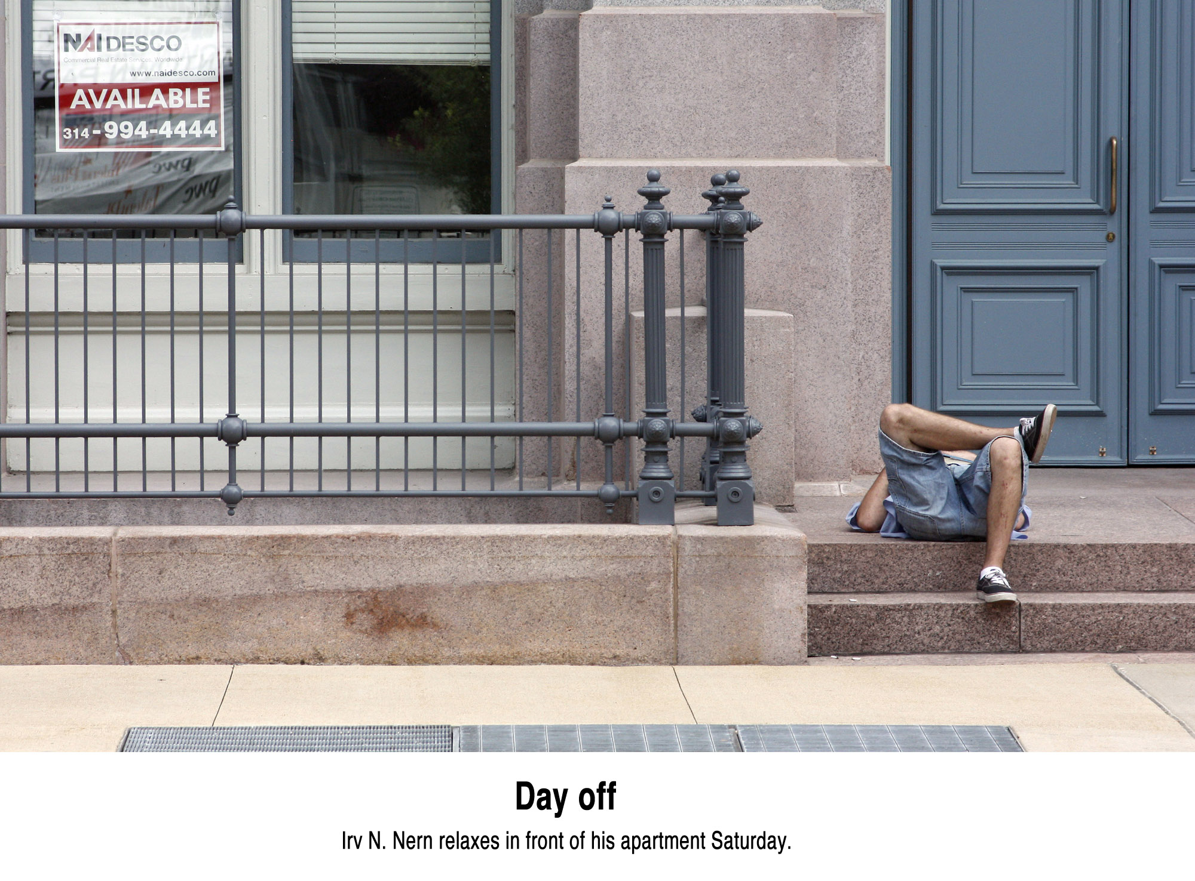
Captions
Strictly speaking, a caption is a small headline above a cutline. But we tend to use the words interchangably.

